Slide 2
CFM Mission
To ensure conservation of Missouri’s wildlife and natural resources, and preservation of our state’s rich outdoor heritage through advocacy, education and partnerships.

Slide 3
Resolutions

Slide 4
In 1935, sportsmen from throughout Missouri came together to form the Conservation Federation of Missouri (CFM). They organized with the purpose of taking conservation out of politics.

Slide 5
Their initiative petition campaign resulted in the creation of the Missouri Department of Conservation, a non-political conservation agency that has been a model for other states.

Slide 6
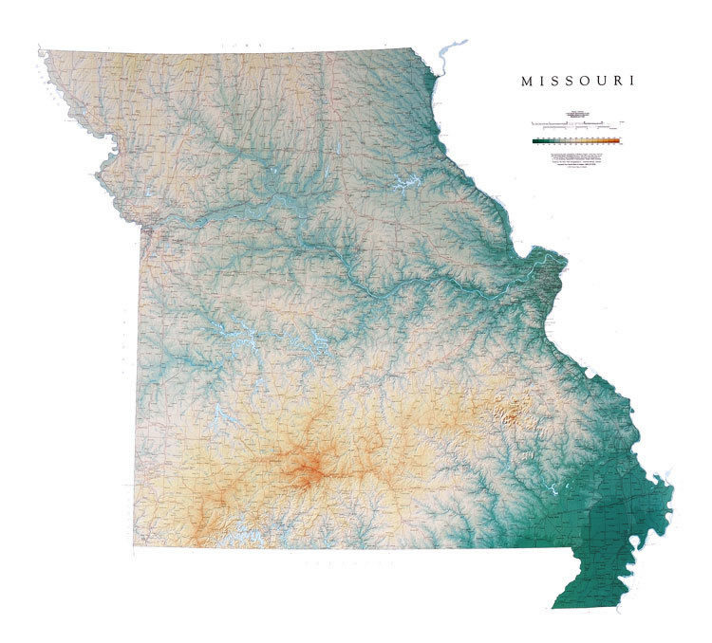
CFM created the first apolitical, science-based conservation agency in the history of the world!

Slide 7
1976 CFM spearheaded successful passage of the conservation sales tax to create stable broad based funding for Missouri’s forests, fauna and fish.

Slide 8
CFM strategic Plan
No single organization can tackle the challenges alone
Serve as a convener, facilitator, and coordinator to build relationships and achieve common goals between and among interest groups
Work with all organizations/agencies to develop and advance programs/policies
Formulate well developed, defensible positions

Slide 9
Importance of Resolutions
Members monitor conservation/natural resource issues
CFM takes positions based on best available information/science
CFM expresses support, opposition, recognition, or advice on particular topic
CFM resolutions are one of the most powerful expressions of our opinion as a conservation organization

Slide 10
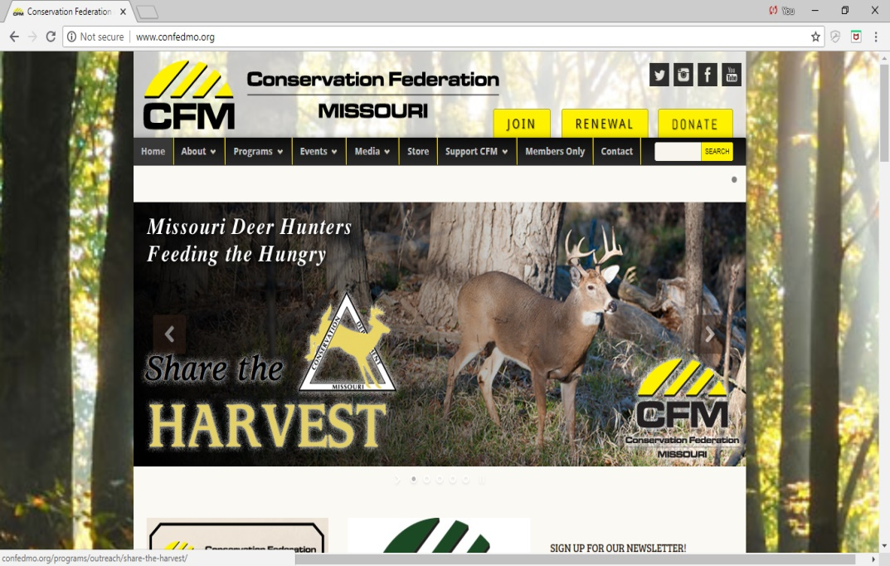
Resolutions Process

Slide 11
Resolutions Process & Timeline
October – December – Resource Advisory Committees (RACs) and CLC begin advance work on the most important issues
December 31 - Deadline for issues submitted to RAC Chairs to be considered for any pre-filed resolutions for the annual convention
January - Individual RACs hold workshops with their official committee members to develop DRAFT resolutions

Slide 12
Resolutions Process & Timeline
February 1 – Deadline for RAC pre-filed DRAFT resolutions submitted to Resolutions Committee
February 15 – Resolutions Committee informs RAC Chairs of pre-filed outcomes
March 1 – Pre-filed DRAFT resolutions are announced on the CFM website for convention attendees.

Slide 13
Resolutions Process & Timeline
Convention Sat. (A.M.) – RAC meetings discussion and voting re: pre-filed DRAFT resolutions
Convention Sat. (P.M.) – Resolutions Committee considers final docket of pre-filed resolutions to determine whether to advance to General Assembly
Convention Sun. (A.M.) – Resolutions Committee presents final resolutions docket for General Assembly vote.

Slide 14
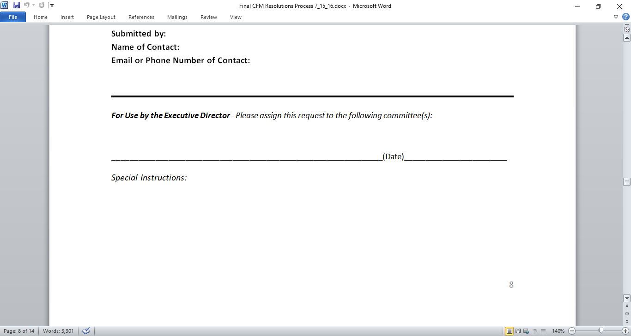
How To submit a Conservation issue/topic

Slide 15
Important issues/topics can be submitted at any time
For Convention
Outside of Convention
Sometimes, less is more…..
Phone call only
Formal Letter from CFM Leadership
Resolution – CFM Policy/Position

Slide 16
Remember:
Always check for existing resolution on same/similar topic
Longer process/timeline allows better fact-finding, input, and Committee discussions
Resolutions focus should be on importance & quality, NOT quantity
Some issues call for more action/advocacy after the successful resolution – NWF training re: Successful Campaigns

